Slide 1


PRECTITVE ANALYSIS
IMAGE SUPER RESOLUTION
GROUP 10
Nelson Lin, zeyu Yang, Liwei Zhang, Max karsok, Feng Su

Slide 2
01
Baseline Model
presentation and make it into a film to used wider field
CONTENT
02
Advanced Model & Results
presentation and make it into a film to used wider field

Slide 3

01
Baseline Model

Slide 4


Features
Gradient boosting is a machine learning technique for regression and classification problems, which produces a prediction model in the form of an ensemble of weak predictions
GBM combine the outputs of many weak classifiers to produce a powerful committee

Slide 5
02
Advanced Model & Results

Slide 6
XGBoost
ADVANTAGES:
Regularization
High Flexibility
Built-in Cross-Validation

Slide 7
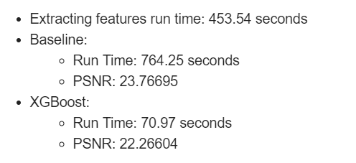
Results
Conclusion：The XGBoost decreases running time by 91% and only sacrifices a 6.3% decline in PSNR

